Slide 1
Advance SolidWorks
By Friend

Slide 2
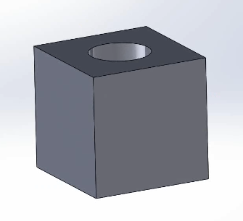
Pre-workshop
Make this part
10mm cube with a 5mm through-hole in the center
Should take less than 5 minutes given the skills you learned during the previous workshop

Slide 3
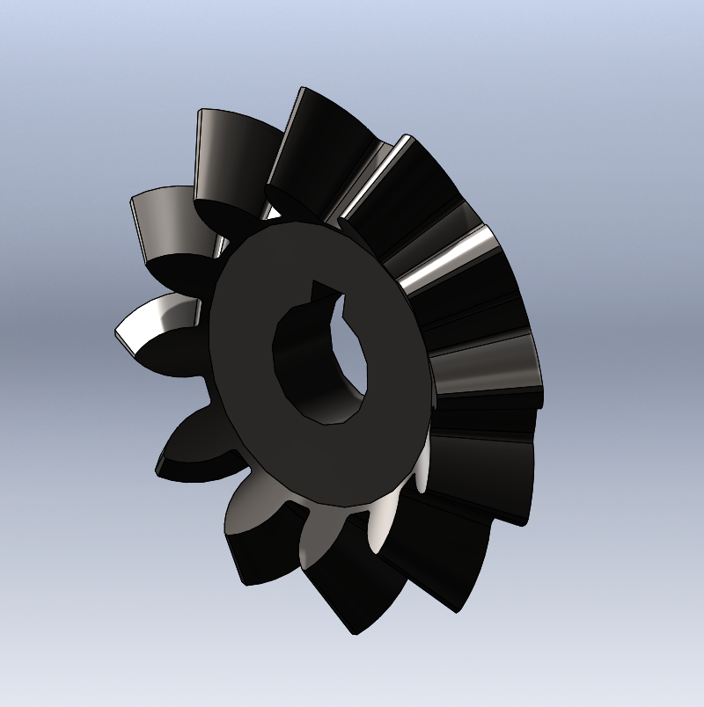
Downloading the gear
Find this gear in this workshop’s folder, and make sure you can open it in SolidWorks
This gear is needed for the assembly.
Fun facts:
Bevel gear is a 90deg gear
Miter gear is a type of bevel gear where ratio is always 1:1

Slide 4
Agenda
Mates, mechanical mates
Motion study

Slide 5
0. Setting up

Slide 6
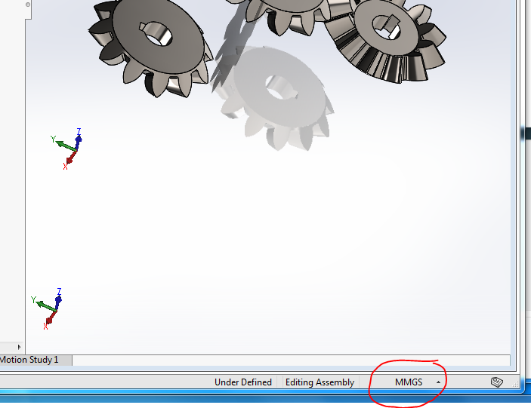
Units
Make sure you’re in MMGS for this tutorial!

Slide 7
4. Mates, mechanical mates

Slide 8
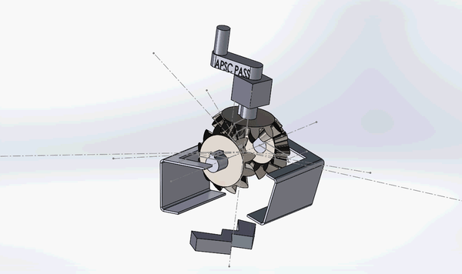
Final product of this section

Slide 9
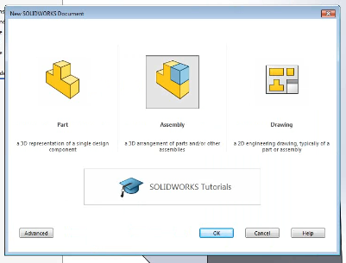
Start a new assembly
File -> New -> Assembly

Slide 10
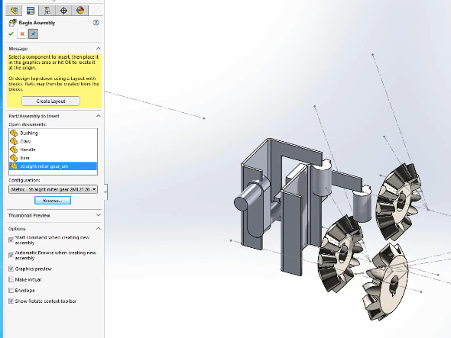
Start a new assembly
“Begin Assembly” window should pop up
Bring in the files accordingly:
X2 “Claw”
X1 “Handle”
X1 “Bushing”
X3 “Miter gear”(given)

Slide 11
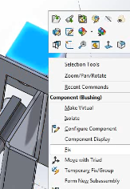
Fix/float
Right click on all the parts to check whether they are float or fix
Make sure the bushing is the only part that is fix
Fix it so that it can’t be moved around while mating

Slide 12
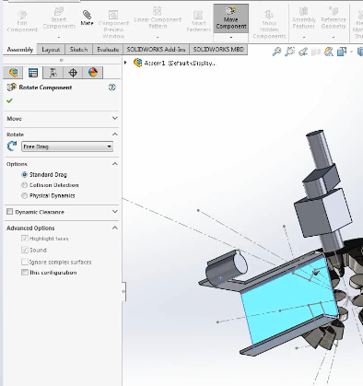
Mating
Step 1:
Check if the orientation of the two pieces are already somewhat aligned or not.
If not, rotate or move them (Pro-tip: right mouse moves; left mouse rotates).

Slide 13
Mating
Step 2:
Think about how the pieces interact with each other. For example, between the gear and the shaft:
You would need a concentric mate so the shaft center aligns with the gear center. However, if this is it, then the shaft would rotate freely inside the gear and the gear wouldn’t turn...
Therefore, you need to add a mate between the key’s(in this case, the key already is a part of the shaft) side-face and the gear’s keyhole. However, if this is it, while the gear would turn, the shaft would be sliding in and out the gear freely…
Therefore, you need to add coincident mate between a end-face and the inside of the gear. Now, if this is it, the shaft would not slide freely while still rotate freely and move the gear with it. Add anymore mates, and the assembly wouldn’t have the movements we want anymore(ie, shaft wouldn’t move freely or the gear would rotate).

Slide 14
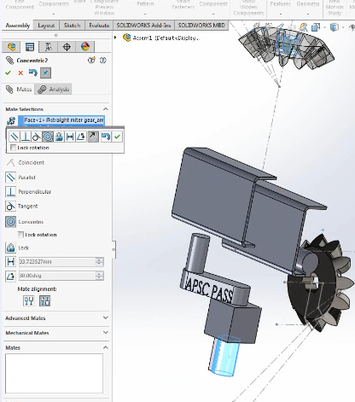
Mating step 2 example: in pictures

Slide 15
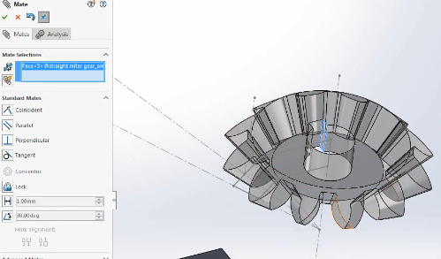
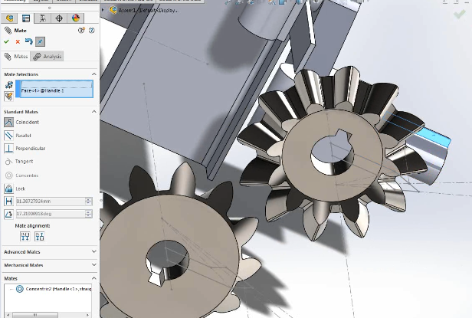
Mating step 2 example: in pictures

Slide 16
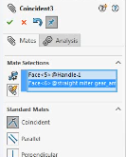
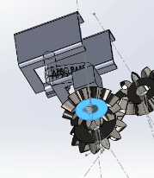
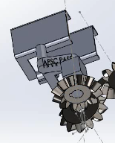
Mating step 2 example: in pictures

Slide 17
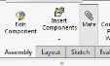
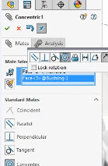
Mating
Step 3:
Add the mates accordingly. Keep adding mates until you get the desired movement, shown earlier on.
Gear movements are shown next slide.
Be patient with yourself. Understanding how things move and interact with each other is a skill that takes time to develop.

Slide 18
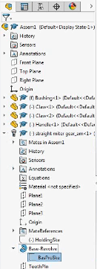
Mating gears
To mate gears successfully, you need to see the drawing lines
On the sidebar, click on the gear -> Base-Revolve -> BasProSke to show the drawing lines

Slide 19
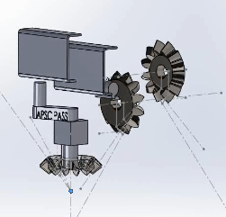
Mating gears
Mate one of the gears to the handle like shown previously
Make sure that the handle is properly mated to the bushing
Orient that gears so that the two other gears are perpendicular to the on-handle gear and facing opposite to each other

Slide 20
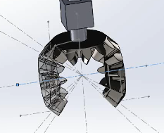
Mating gears
Select the point on the gear drawing where the lines converge
Coincident mate this point of all three gears together

Slide 21
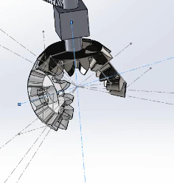
Mating gears
Perpendicular mate the rotating line of the two gears perpendicular to each other
In this picture, the other gear is rotated slightly to more clearly show the square of the other two gear

Slide 22
Mating gears
Perpendicular mate the rotating line of the two gears perpendicular to each other
In this picture, the other gear is rotated slightly to more clearly show the square of the other two gear

Slide 23
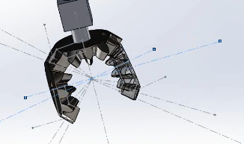
Mating gears
Coincident mate the rotation lines of the two gears that are facing each other

Slide 24
Mating gears
Coincident mate the rotation lines of the two gears that are facing each other

Slide 25
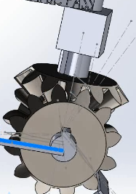
Mating gears
Align the gears so that the teeth don’t hit each other
This won’t matter for Soldiworks to generate the gear movement, but it looks nicer

Slide 26
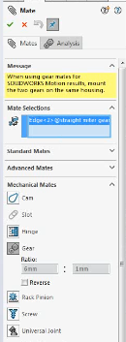
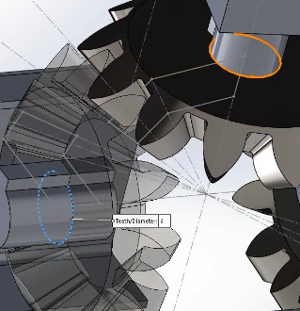
Mating gears
Mate -> Mechanical Mates -> Gear
Select the two shaft hole edges
Ratio can be any number, as long as it’s 1 to 1
Solidworks should pre-select 1:1 for you
Miter gears are a special type of bevel gear that are 1:1 ratio

Slide 27
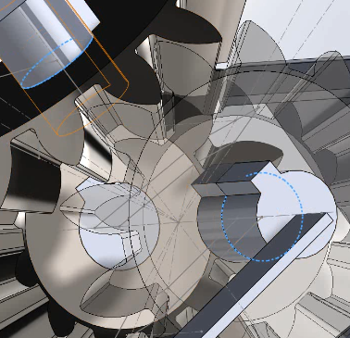
Mating gears
Repeat for the other gear

Slide 28
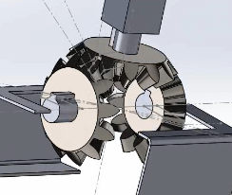
Mating gears
Your gear mates are done!

Slide 29
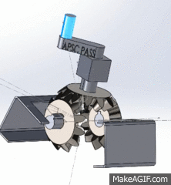
Done!
When you have added all your mates, you should get this movement.
Save the file as “Assembly”, but don’t close it yet.

Slide 30
5. Motion study

Slide 31
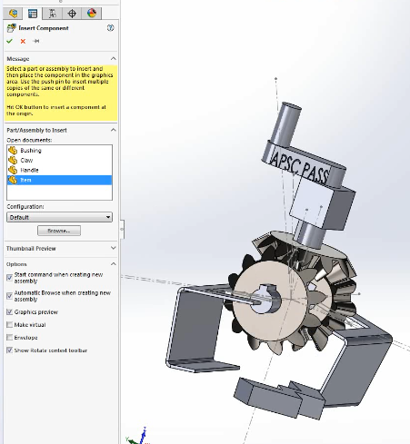
Motion study
Insert “Item”
Move it so that it’s somewhere in the bottom of the claw

Slide 32
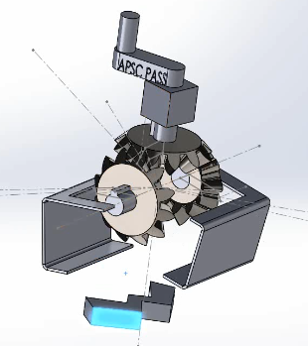
Motion study
Align your view so that you can see the claw work nicely
Something like this view
Solidworks will use the view you have currently as the view in the motion study
It’s possible to change view, but it’s much easier to adjust to a good view now

Slide 33
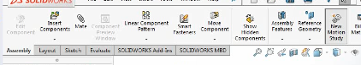
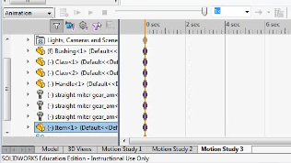
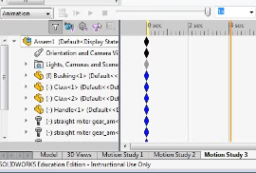
Motion study
Click “New Motion Study”
You’ll see a timeline in the bottom of the screen
Drag the time bar to around 4 s

Slide 34
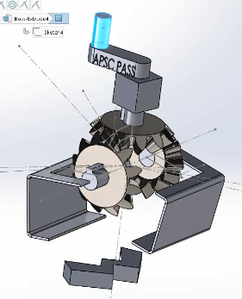
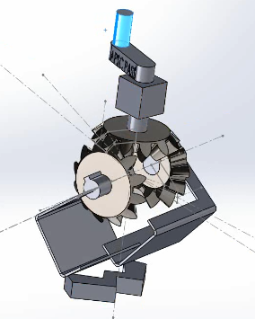
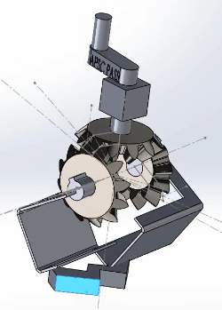
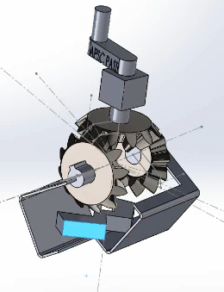
Motion study
Move the handle and the item as if the claw is working to pick the item up
You should have only 2 keyframes at 4 s mark

Slide 35
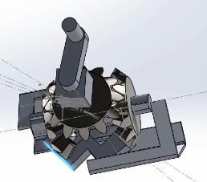
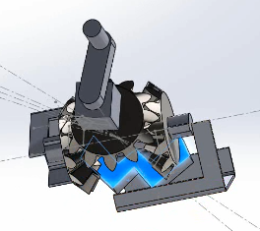
Motion study
Rotate around to see from different angles whether the item is inside the claw or not
Adjust accordingly

Slide 36
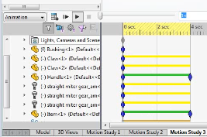
Motion study
Wind back to the 0 s and press play to check whether the animation came out right
What happened when I did this check is that the claw was moving fine, but the item didn’t move until it jumped to place in the end; don’t worry, because generally as long as the keyframes are right, the animation will come out fine

Slide 37
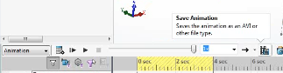
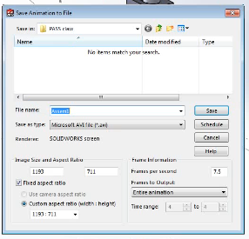
Motion study
Click “Save Animation” if you’re good with what you have
This window will pop up
Name your file, choose where to save it, and leave other settings as is
Click “Save”

Slide 38
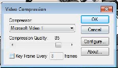
Motion study
This window will pop up
Untick the “Key frame every n frames” option
When I did it, rendering usually fails unless I untick this; might not fail for you though
Click “OK” and let the program render

Slide 39
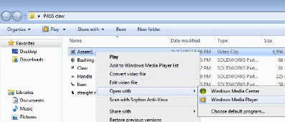
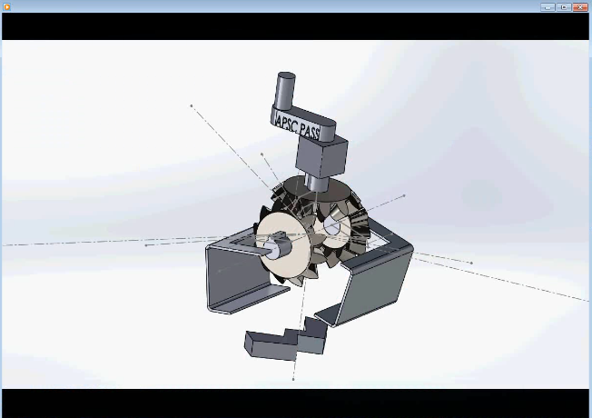
Done!
Save your assembly
Try playing your video!

Slide 40
Some further readings
Engineering drawing https://www.solidworks.com/sw/resources/getting-started-part-and-assembly-drawings.htm there should also be a tutorial you can follow along when you download SolidWorks
Other SolidWorks introductory resources https://www.solidworks.com/sw/resources/getting-started-with-solidworks.htm

